Slide 1

SUSTAINABILITY REPORT
2025

Slide 2
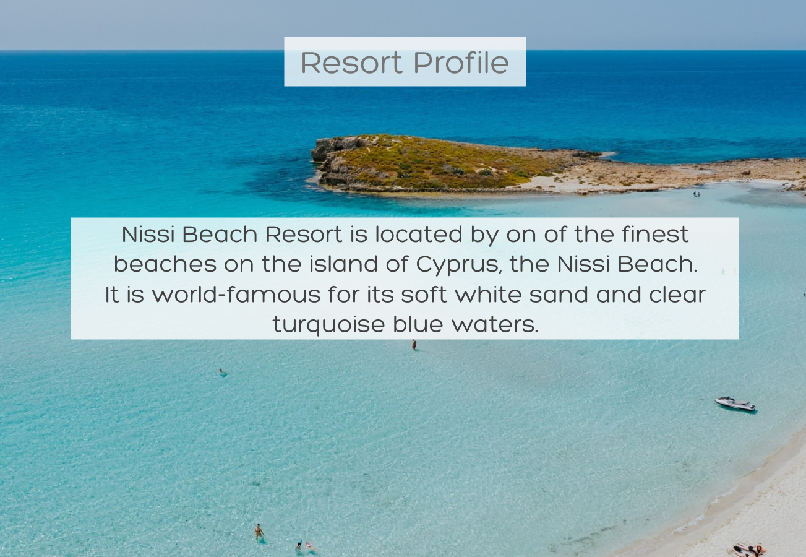

Slide 3

Environmental & Circular Economy Policy Statement
Nissi Beach Resort is dedicated to minimizing its carbon footprint and fulfilling environmental obligations through the following initiatives:
Adopting circular economy principles to reduce waste, conserve resources, and enhance sustainability.
Utilizing energy-efficient technologies and renewable energy sources.
Promoting energy and water efficiency, reducing consumption, and opting for sustainable materials.
Minimizing waste generation by avoiding excessive packaging and single-use plastics.
Implementing waste segregation and robust recycling programs.
Prioritizing sustainable products designed for longevity or recyclability.
Educating staff on environmental responsibility through continuous training.
Establishing targets to decrease greenhouse gas emissions, electricity, fuel, and water usage.
Continuously improving environmental management and emergency readiness.
These efforts are aligned with the Circular Economy Model, TraveLife, and ISO 14001 standards.

Slide 4

SAVING ENERGY
We continuously upgrade our equipment to include energy-saving devices, aiming to reduce energy consumption.

Slide 5


Electricity (kWh per guest night)
19.02 kWh
21.33 kWh
Until end of August
20.60
kWh
2023
2024
2025

Slide 6



PETROL AND GAS CONSUMPTION (KWH PER GUEST NIGHT)
Until end of August
0
kWh
0.86kWh
0.22
kWh
2023
2024
2025
Until end of August
6.22
kWh
6.51kWh
6.47 kWh
2023
2024
2025

Slide 7


TOTAL ENERGY CONSUMPTION (KWH PER GUEST NIGHT)
26.54
kWh
28.70
kWh
Until August
26.81
kWh
2023
2024
2025
Overall Nissi Beach Resort has reduced its energy consumption by more than 16% since 2004, when it was first certified to ISO 14001 in recognition of its sustainability initiatives.

Slide 8

SAVING WATER
We believe in reasonable use of water, and we strive to reduce consumption and minimize waste

Slide 9


WATER (M3 PER GUEST NIGHT)
0.23
0.22
Until end of August
0.21
2023
2024
2025

Slide 10

WASTE MANAGEMENT
We prioritize waste reduction and efficient recycling throughout the complex, including the beach. Recycling has increased by 30% compared to last year, significantly cutting waste and reducing environmental pollution.

Slide 11

General waste (kg)
2023
1017652
2024
1033765
2025
Until end of August
692547
Total general waste/guest night (kg)
2023
10.03
2024
10.68
2025
Until end of August
13.74

Slide 12





Recycled Waste
 | 2023 (kg) | 2024 (kg) | 2025 (kg)
Plastic | 39060 | 94648 | 14280
Paper | 11400 | 46300 | 24550
Glass | 18000 | 19200 | 9600
 | Battery (kg) | Ink/toner (kg) | Lamp (kg) | Used oil (liter)
2023 | 55 | 25 | 83 | 4665
2024 | 58 | 21 | 130 | 5900
2025 | 15 | 11 | 93 | 2810

Slide 13

Tree Trimmings (kg)
2024
164000
2025
64069
Tree Trimmings (kg)/guest night
2023
5.89
2024
1.73
2025
0.40

Slide 14

Total chemical consumption (Liters)
19787
2024
32224
2025
Total chemical consumption / Guest night (Liters)
0.30
2024
0.34
2025

Slide 15
Chemical consumption of each department (Liters)
F&B
2024
15326
2025
10302
MAINTENANCE
Stereo
2024
470
2025
353
Liquid
2024
11853
2025
6411
HOUSEKEEPING
2024
4428
2025
2612

Slide 16
Chemical consumption of each department/guest night (Liters)
F&B
2024
0.16
2025
0.30
MAINTENANCE
Stereo
2024
0.005
2025
0.01
Liquid
2024
0.13
2025
0.10
HOUSEKEEPING
2024
0.05
2025
0.04

Slide 17

Sustainability Activities
Solar power and heat recovery systems reduce energy consumption.
Energy-saving systems installed in beach suites and bungalows.
Over 90% of the premises use LED lighting.
Heat/motion detectors added in public areas.
Dual flush toilets and eye-detect water fountains in use.
Recycled water irrigates the gardens.
50% of goods and services are bought locally.
Over 60% of fresh produce is sourced from local suppliers.
Installation of a BMS system since 2025

Slide 18
Sustainability Activities
Bulk chemicals are purchased, and containers are returned to suppliers.
Liquid and solid waste are handled by licensed suppliers and recyclers.
Organic waste is recycled using specialized equipment.
Towel and linen exchange policy saves water, chemicals, and electricity.
Plastic use reduced by 80% since 2019; paper straws, reusable plastic, and stainless-steel cutlery are used.
New shampoo and soap dispensers
Local dishes and herbs, like kolokasi and mint for mojitos, are promoted on the menu.
Employees receive sustainability training; guests and staff are informed via social media, flyers, and the environmental board.

Slide 19
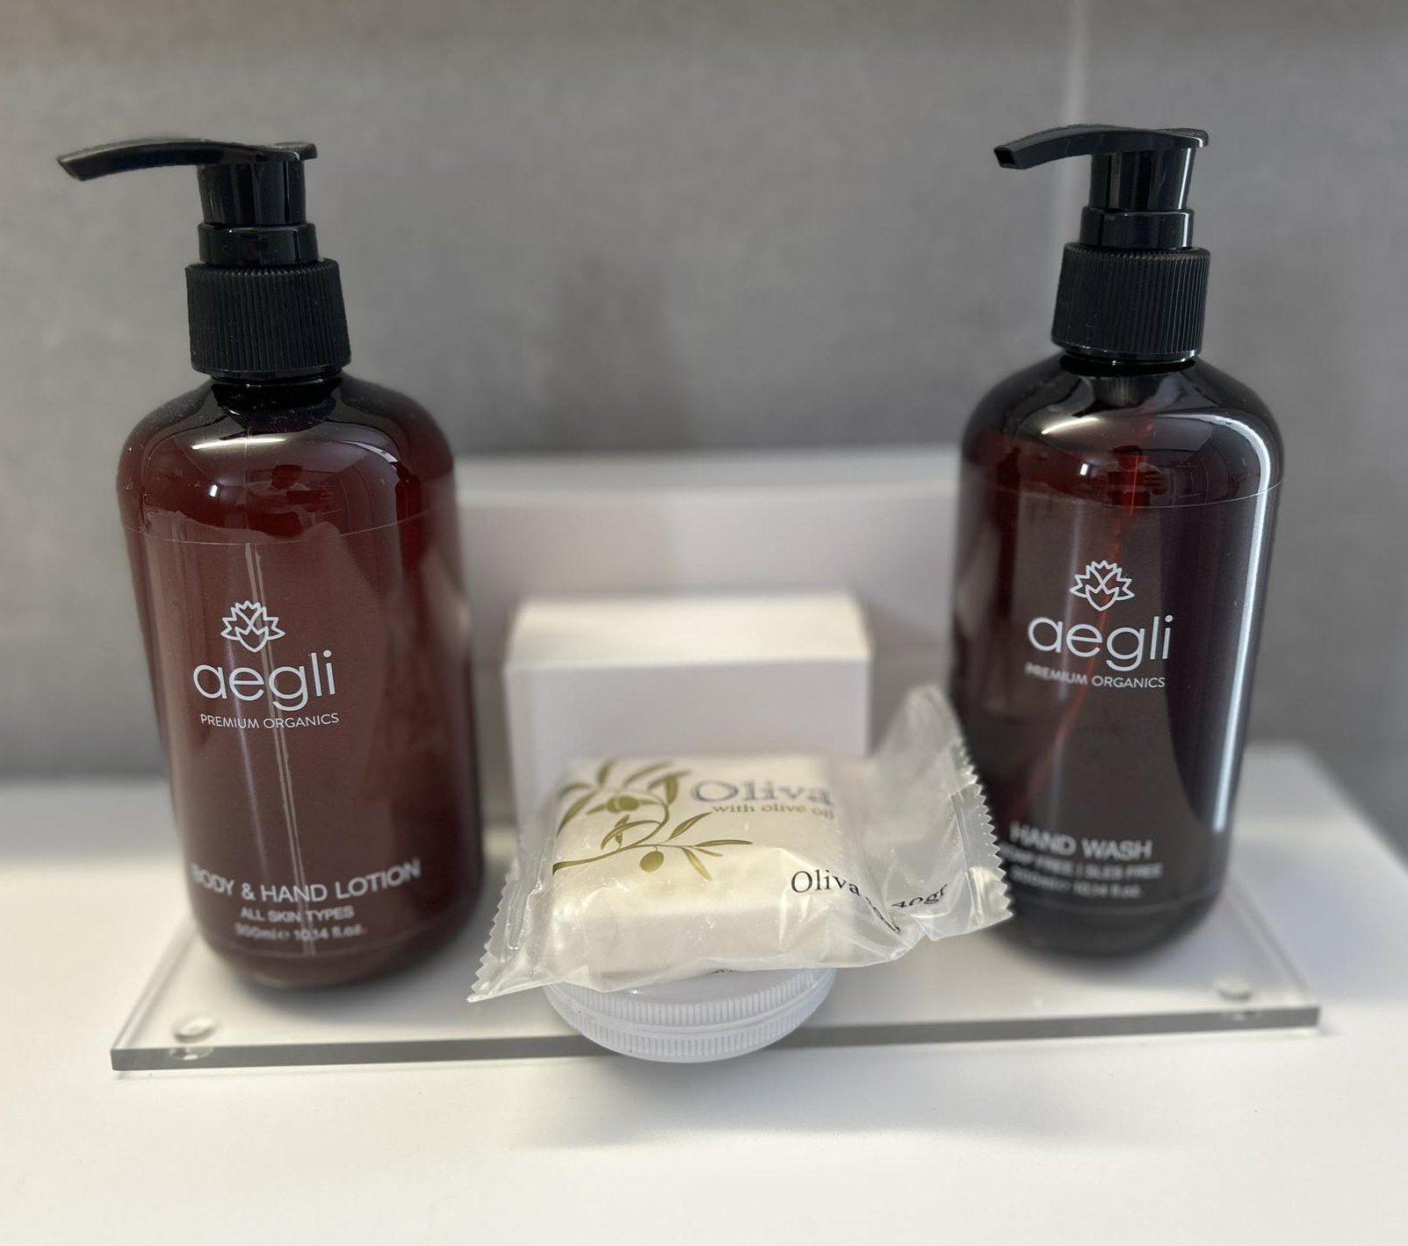
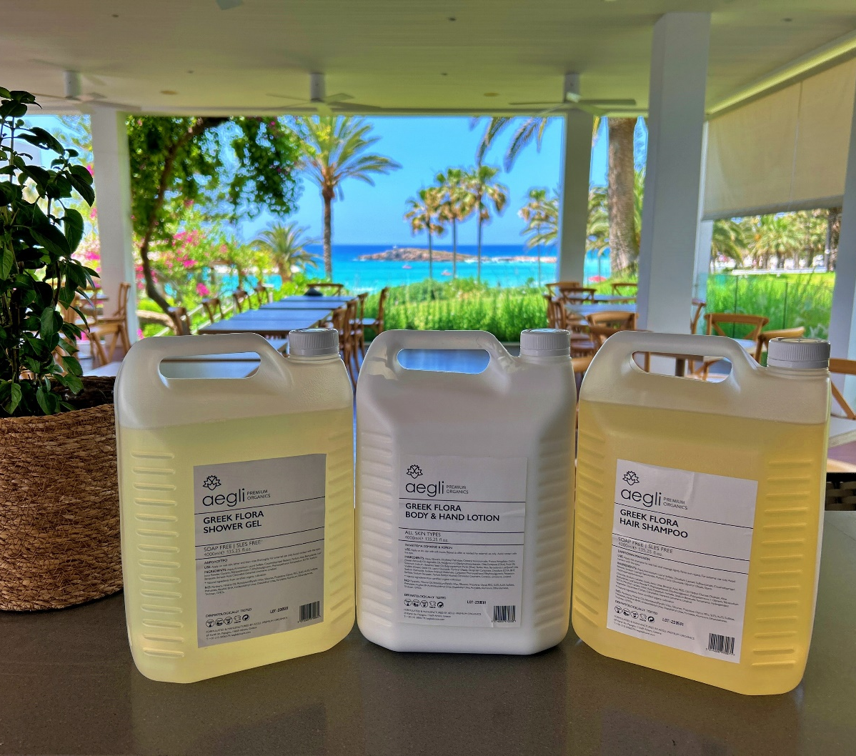

Slide 20
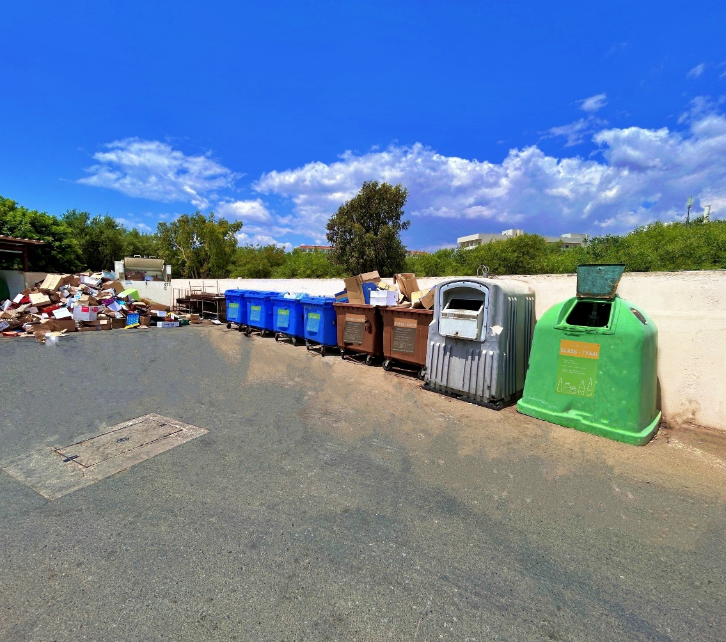
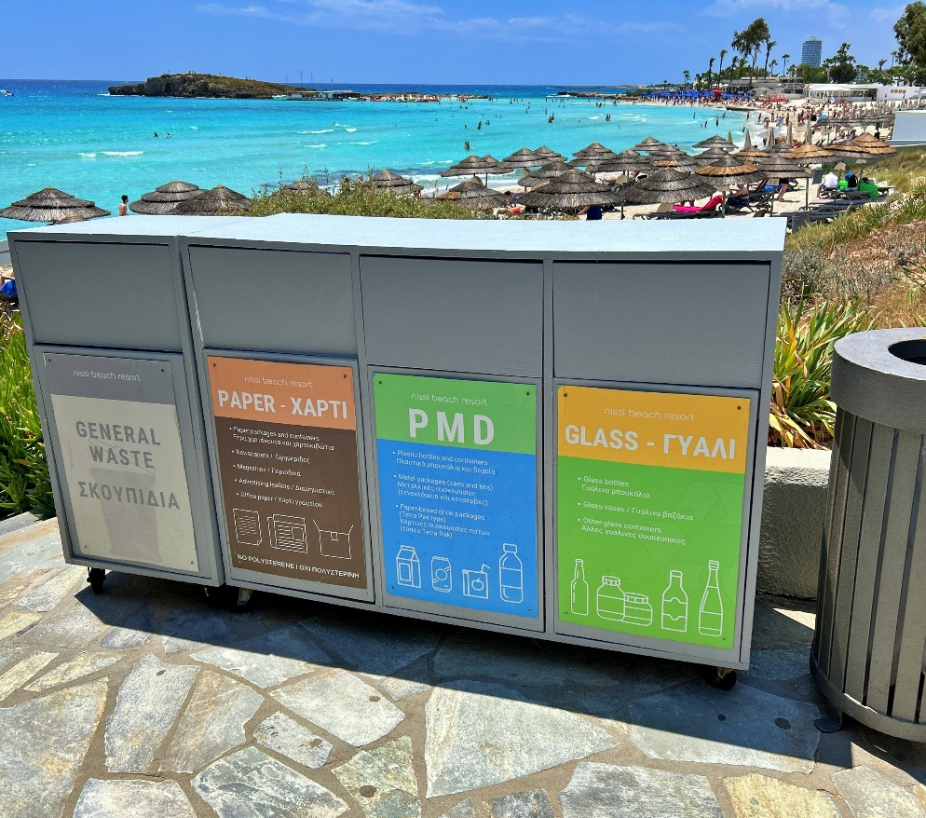

Slide 21
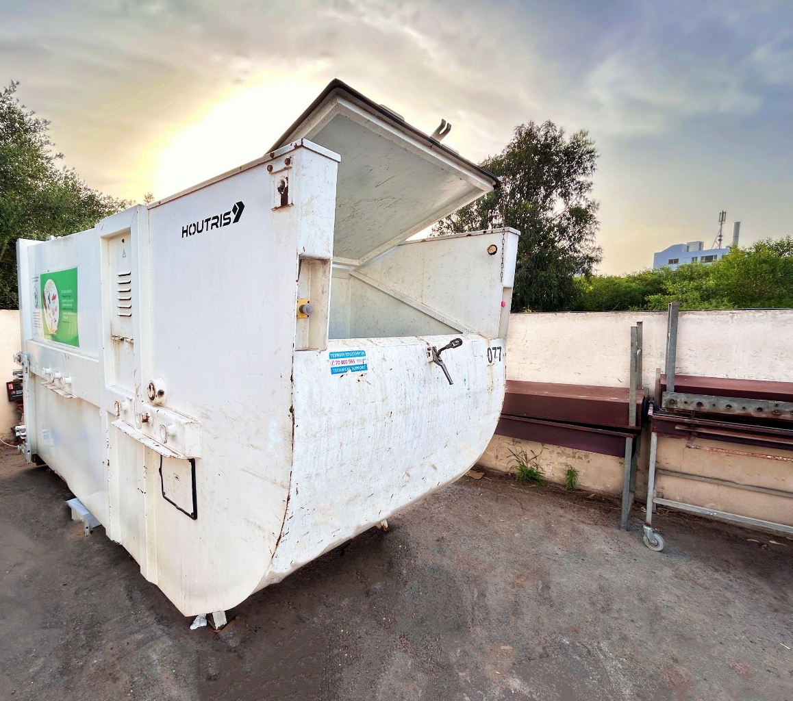
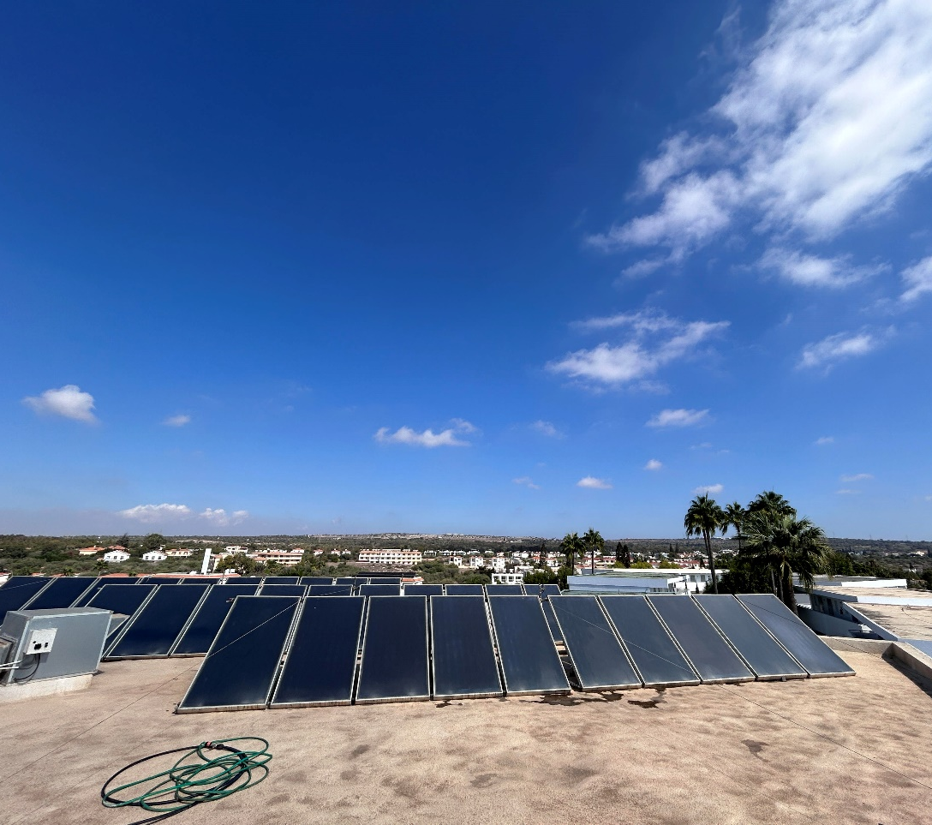

Slide 22
Removed all the plastic glasses and other plastic items as follows:
Main Bar – No use of plastic /September 2021
Pool Bar – Use of Reusable glass for the last 10 years
Rondavel – Replaced all plastic items /September 2021
Taverna – Use of reusable glasses instead of glass
Petra & Puma – Replaced plastic b/ March 2020
Luma – Lsing of paper and reusable glass 2023

Slide 23
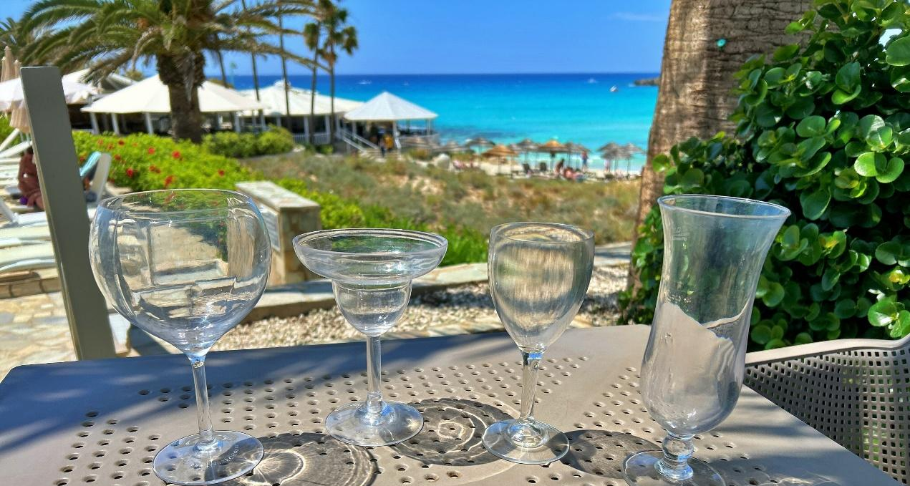
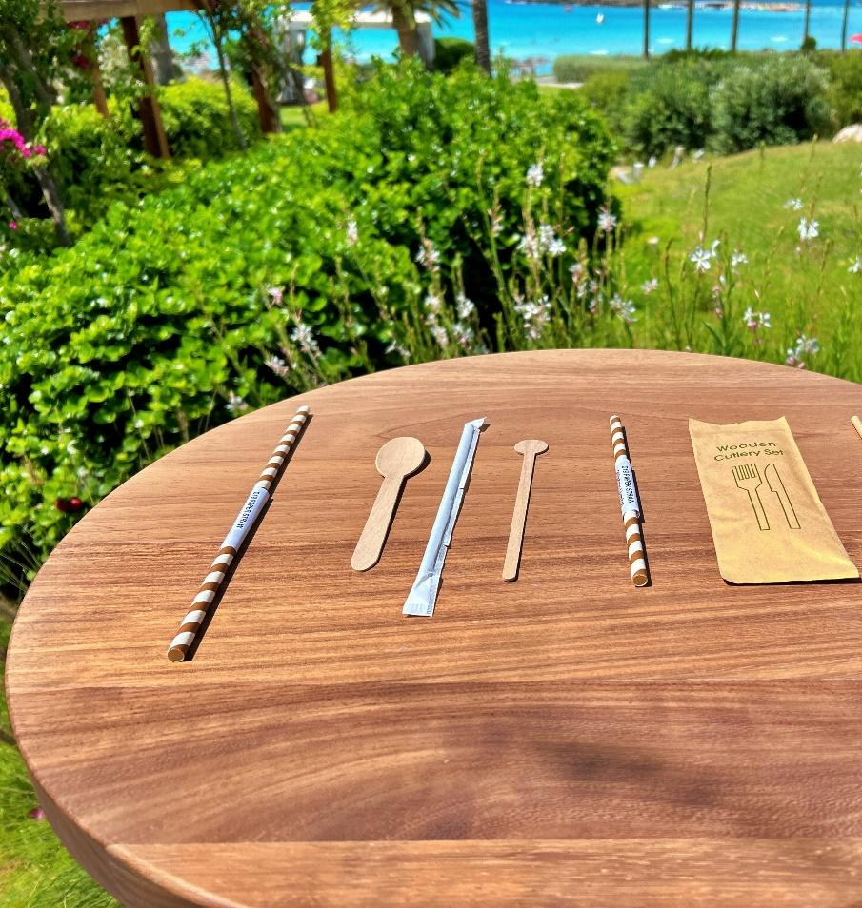
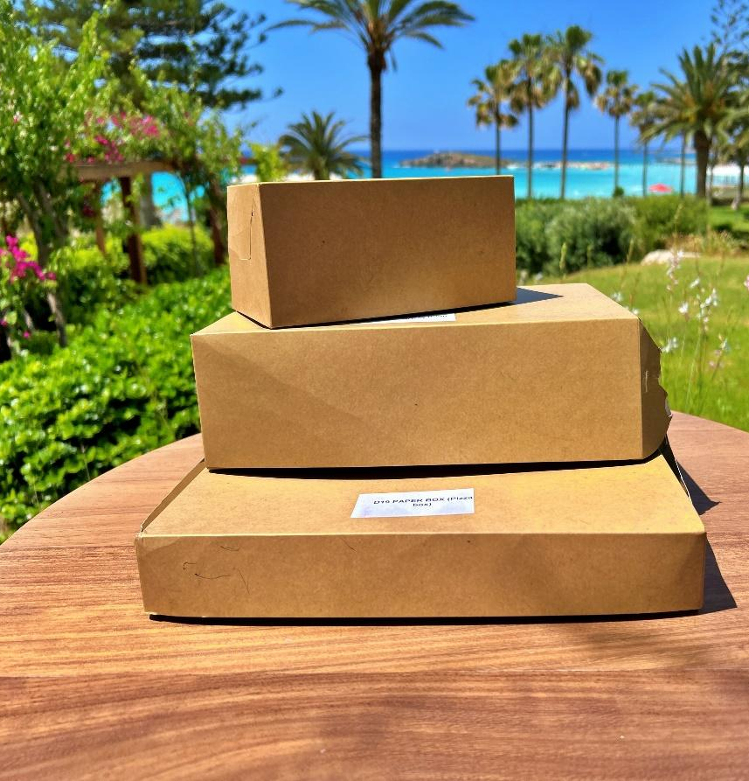
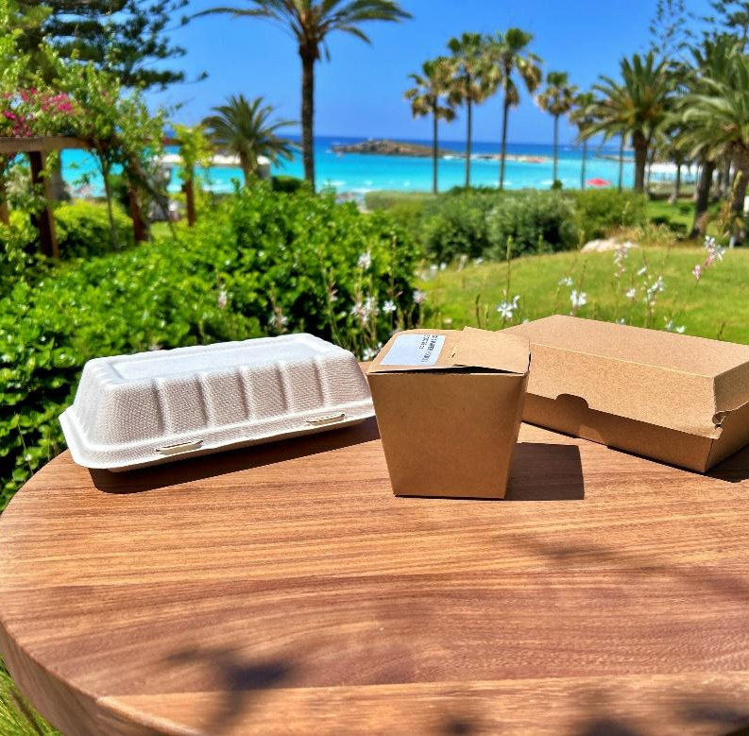

Slide 24

Circular Economy
Nissi Beach Resort is dedicated to sustainable improvement and has joined the governmental scheme to promote circular economy practices. The hotel received the Silver Award for Circular Economy in September 2023 and aims for the Gold Award by 2025. Key initiatives include:
Conducting online departmental meetings when possible.
Encouraging bus usage and carpooling, especially for housekeeping and kitchen staff.
Fully financing staff bicycles; over 40% of seasonal staff use bikes coming
to work.
Donating furniture from recent renovations to charities, nursing homes, and monasteries.
Giving bed linen and towels to nursing homes.
Composting tree trimmings on-site or at the Ayia Napa Green Point.

Slide 25
Circular Economy
Reducing
Reducing food waste by following recipes and repurposing unused aromatic plants into sauces.
Minimizing
Minimizing leftover food, which is given to staff or local farmers for animal feed.
Collecting
Collecting cooking oil for energy production by Venzoil.
Continuing
Continuing community social activities annually.
Encouraging
Encouraging walking to work for seasonal staff to promote a healthy lifestyle and reduce traffic congestion.

Slide 26
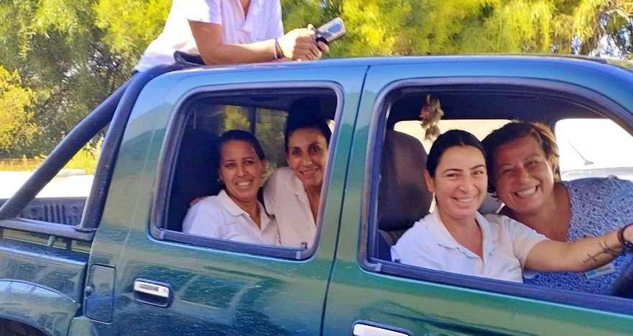
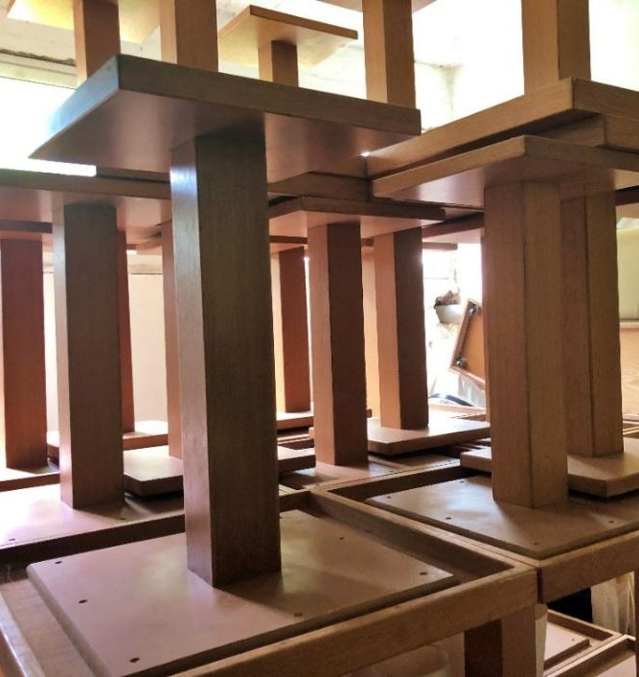
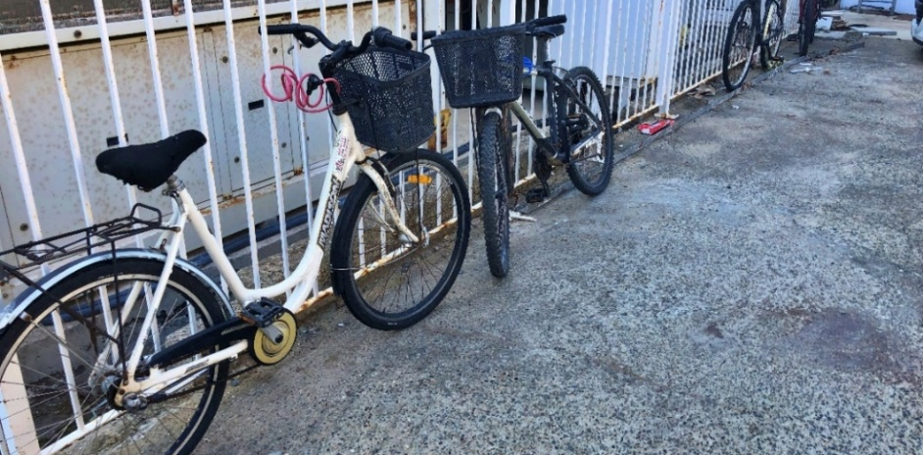

Slide 27
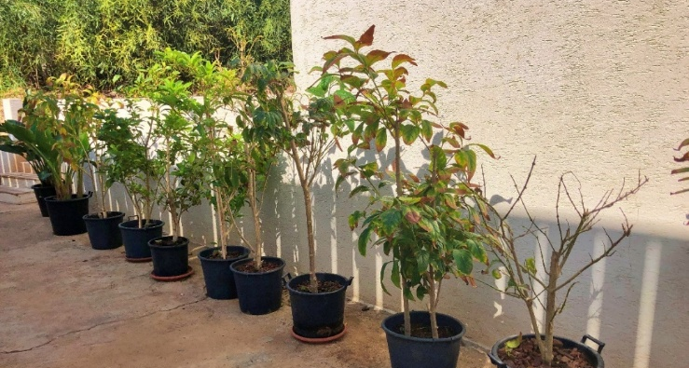
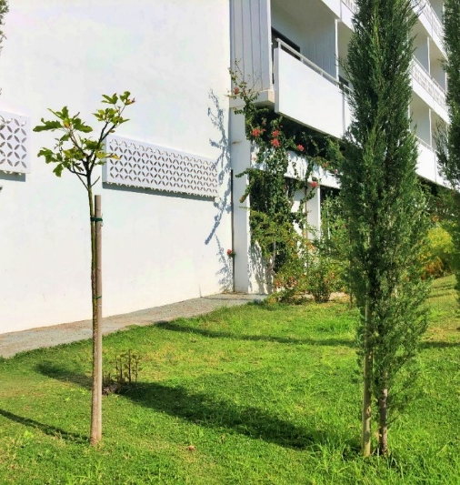
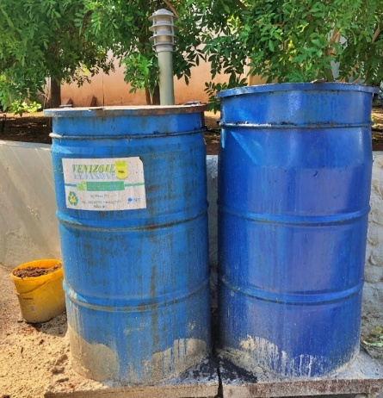
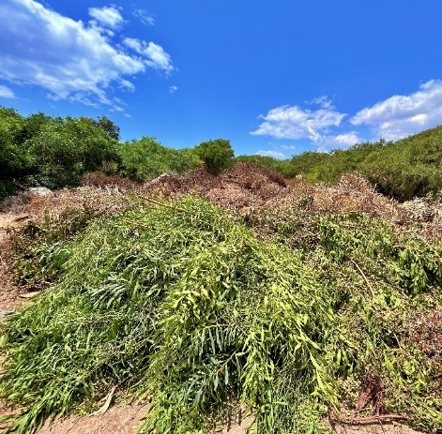

Slide 28

SAND DUNES PROJECT
The hotel has preserved and expanded the natural endemic plants on Nissi Beach, following Green Beach Project guidelines. Non-local Acacia plants were removed (70%) and replaced with native Lycium.
Efforts focused on increasing the population of local sea lilies by planting over 500 seeds with successful results.
Successfully preserved and expanded the rare endemic plant Euphorbia Paralias.
Over 15 wild, natural plants identified, classified, and preserved with name labels for visitors to enjoy.
Key Species:
Sea Daffodil (Pancratium maritimum) - Blooms July to October.
Seaside Spurge (Euphorbia Paralias) - Blooms February to December, with milky sap that is poisonous.

Slide 29
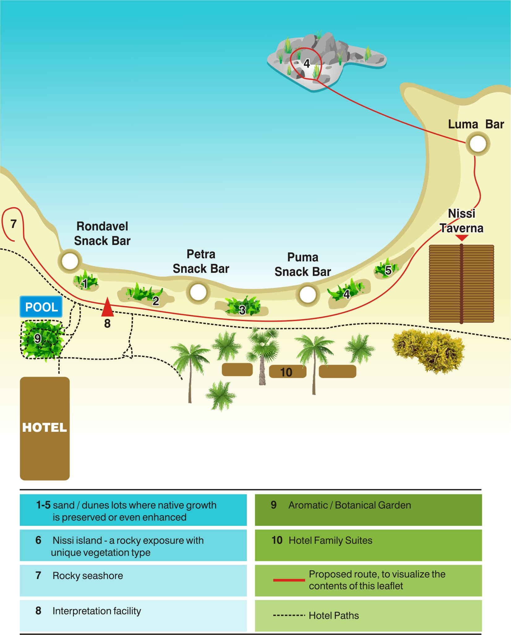
SAND DUNES PROJECT

Slide 30
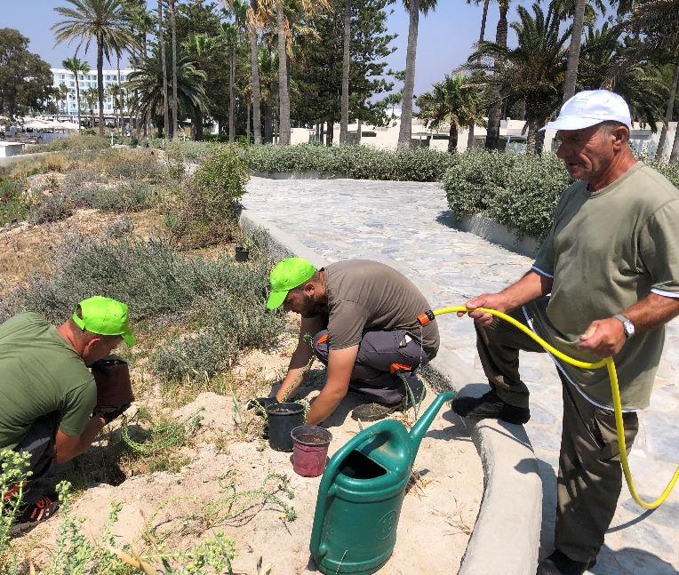
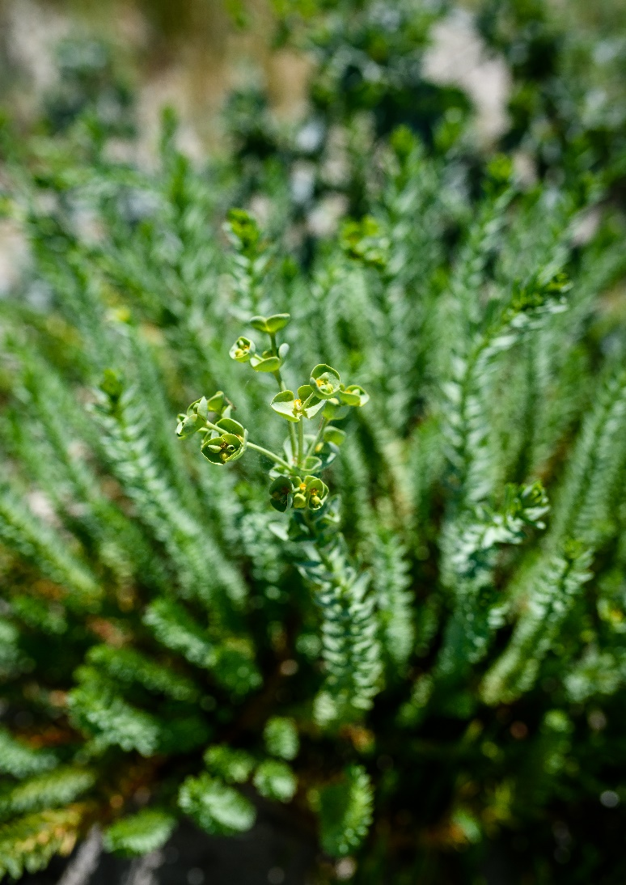
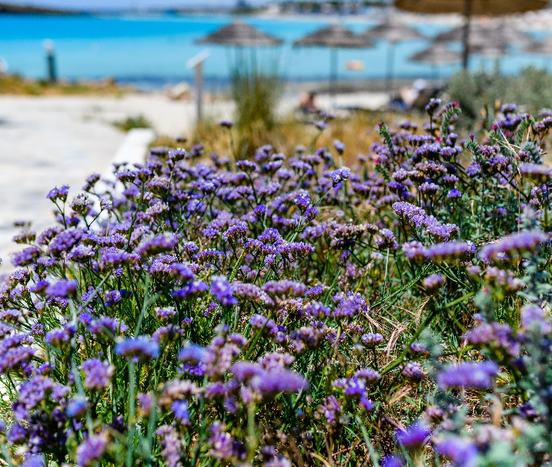
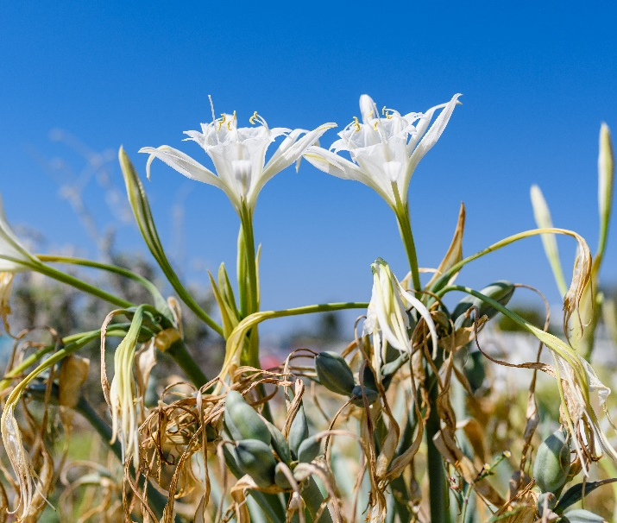
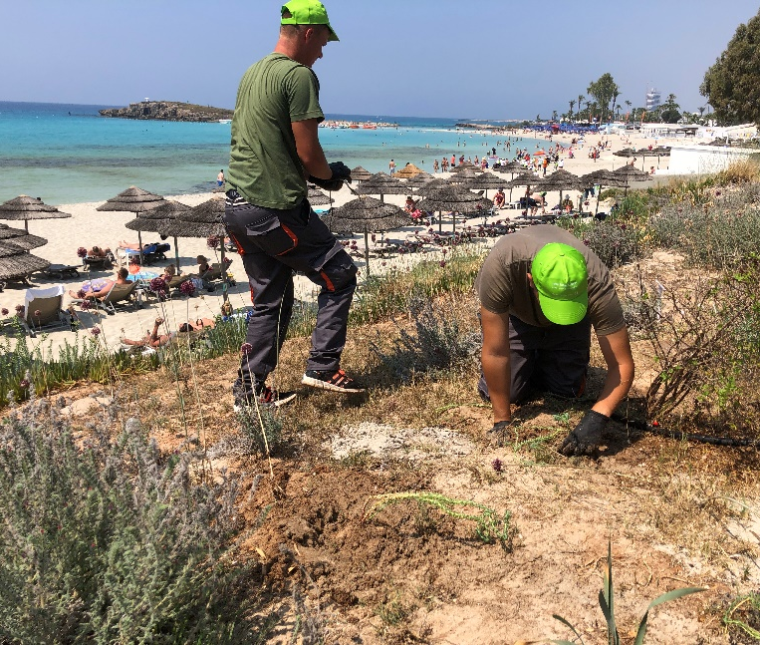

Slide 31
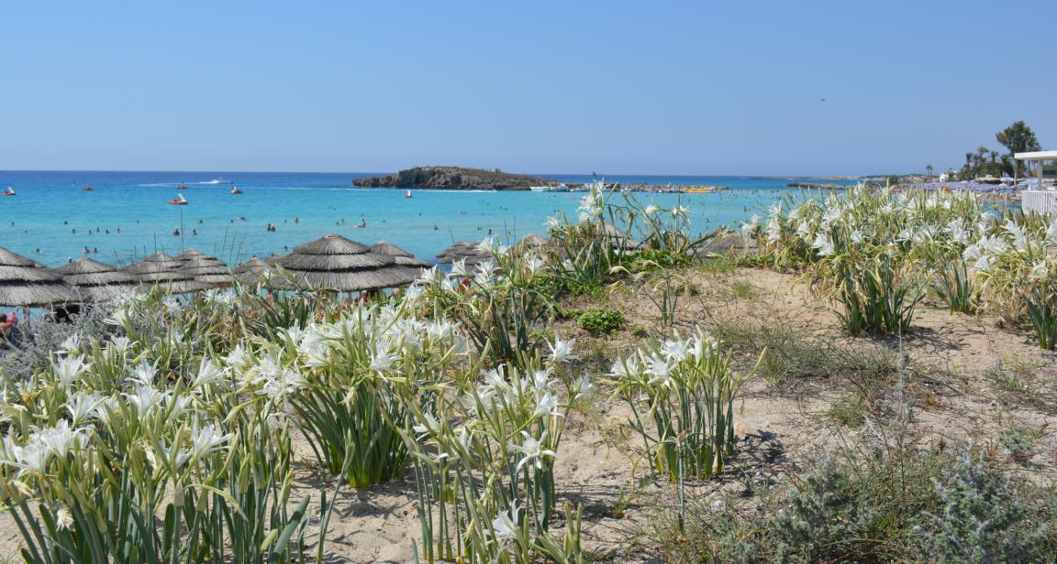
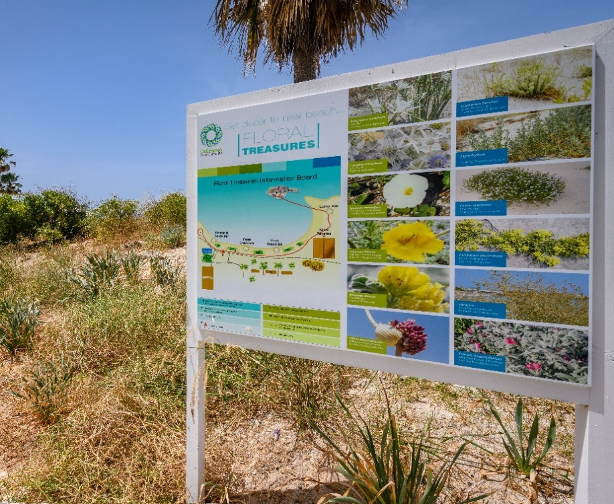
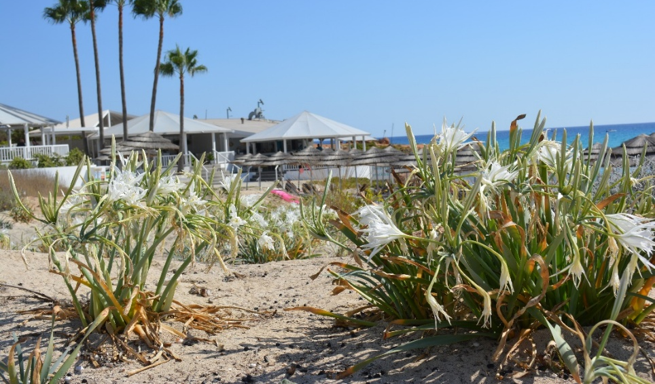
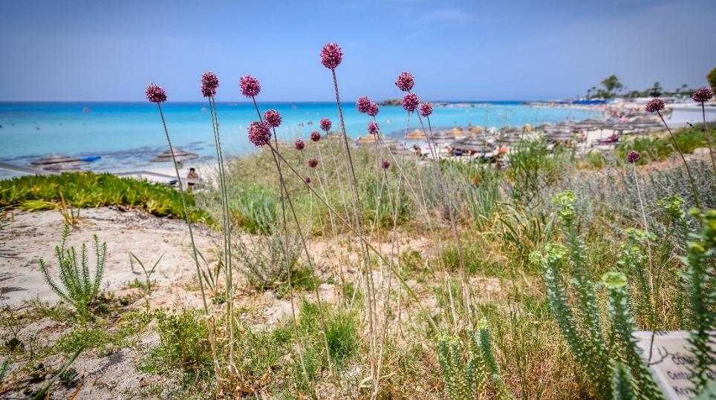

Slide 32

SOCIAL RESPONSIBILITY
The Hotel has been active with social and community activities offering donations and participating and supporting various local activities.

Slide 33

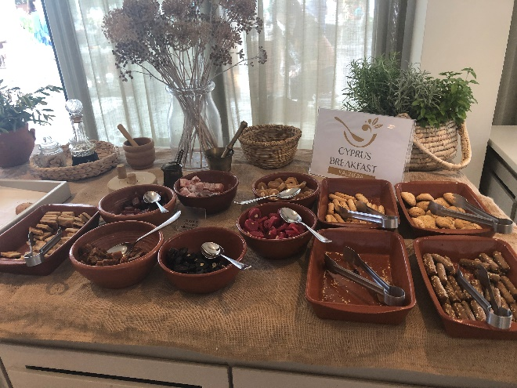
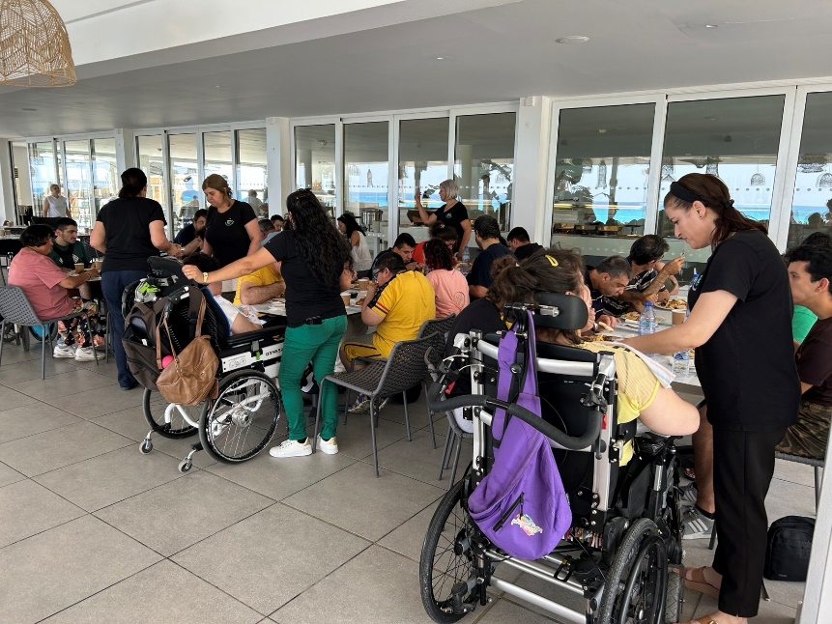
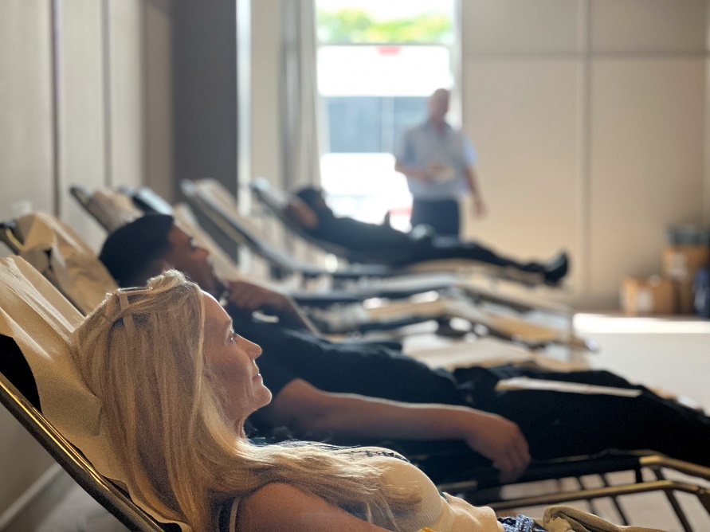
Supporting Sophia for children
Serving Cyprus Breakfast
Lunch for people with special needs
Blood donation

Slide 34
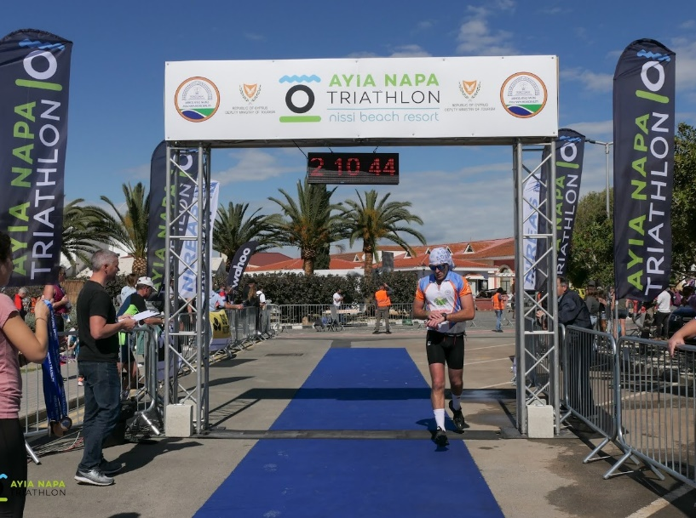
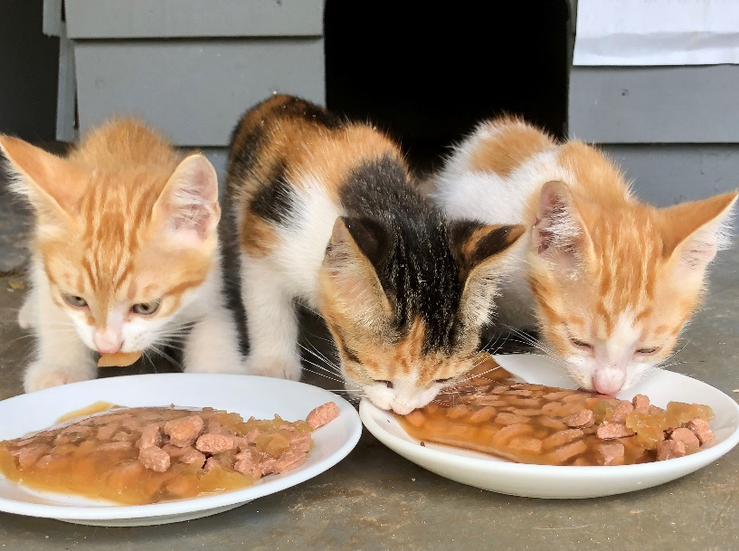
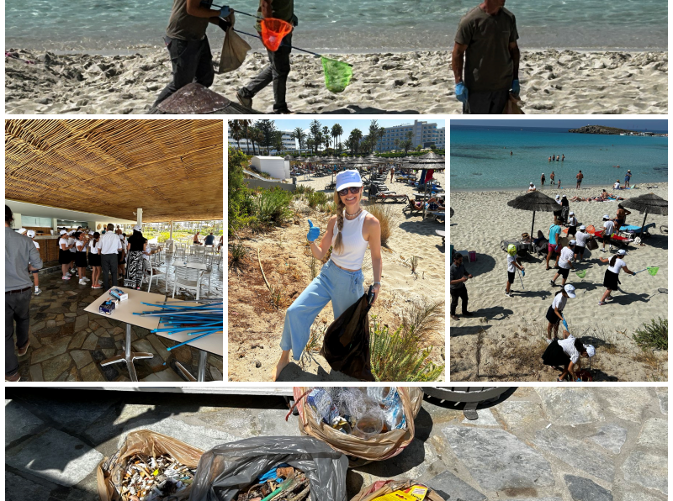
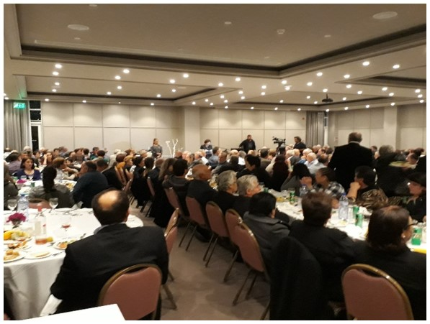
Ayia Napa Triathlon
Saving stray cats
Annual beach cleaning day
Dinner for ‘Melathron Agoniston’

Slide 35

CUSTOMER SATISFACTION
Our guests continue to trust Nissi Holiday Resort for their holidays and the percentage of repeaters is >30%, which shows clearly their satisfaction.

Slide 36

HUMAN RESOURCES
At Nissi Beach Resort, we ensure a safe workplace that respects human rights, following union agreements and applicable laws.

Slide 37
Employees | 2023 | 2024 | 2025
Male Employees | 182 | 169 | 217
Female Employees | 159 | 162 | 132
Local Staff | 207 | 189 | 196
Other nationalities | 134 | 142 | 153
We are an equal opportunity employer, committed to protecting the human rights of our employees, business partners, and the community. New employees are informed of their employment terms, including pay and welfare, before starting work.

Slide 38
Training Provided | 2023 | 2024 | 2025
External training (# of programs / hours) | 132 | 48 | -
On the job training (# of programs / hours) | 177 | 676 | 79
Total training (# of programs / hours) | 309 | 724 | 79
Training hours / employee | 2,30 | 2,66
The greatest asset of Nissi Beach Resort is our employees, and we invest heavily in their continuous training and development and the upgrading of their skills.

Slide 39

CHILD PROTECTION
At Nissi Beach Resort, we ensure children's safety by following strict Child Protection guidelines and international laws, with proactive measures to combat child abuse in tourism.

Slide 40


We have maintained TraveLife Gold Certification for many years, an internationally recognized sustainability standard for the travel industry. Our hotel excels in sustainability and encourages others to pursue continuous improvement while actively sharing our progress.

Slide 41



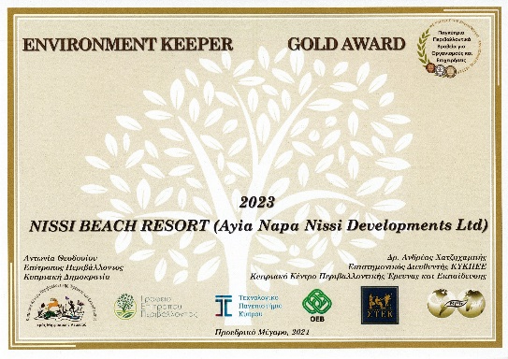

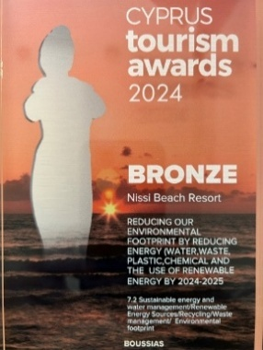
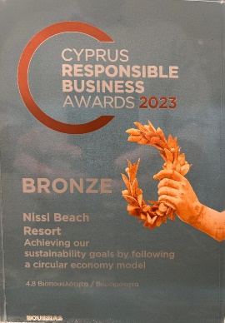
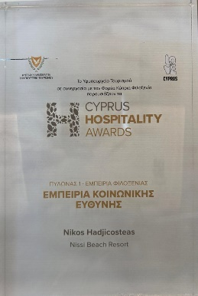
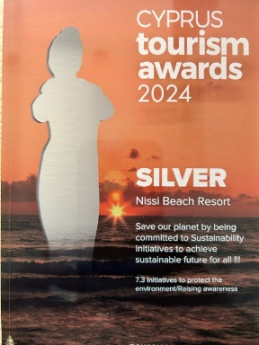
OUR SUSTAINABILITY AWARDS

Slide 42
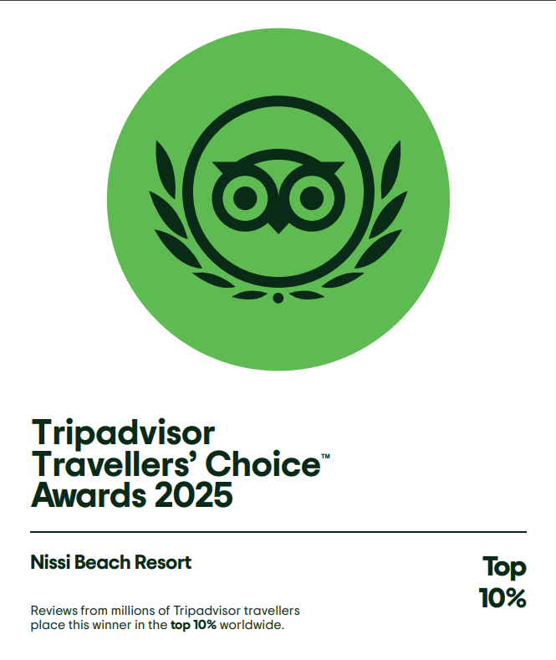





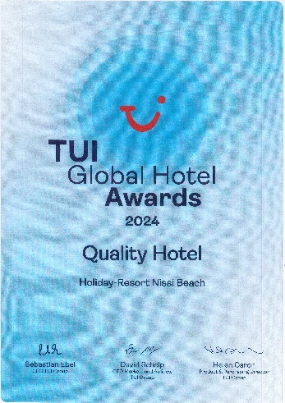
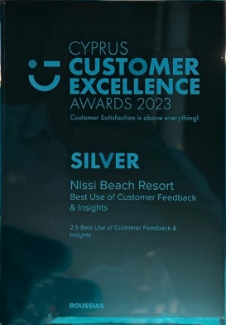
OUR QUALITY AWARDS

Slide 43
This is a teamwork effort !

